Slide 1
Be
Luke
Dr. Rick Griffith • Crossroads International Church Singapore
BibleStudyDownloads.org

Slide 2
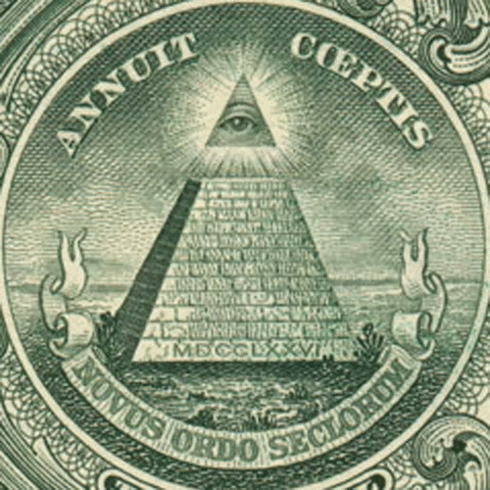
Are you a believer?
Notes:
Tell me if you believe these claims:
Many conspiracy theories surround the US dollar bill.

Slide 3
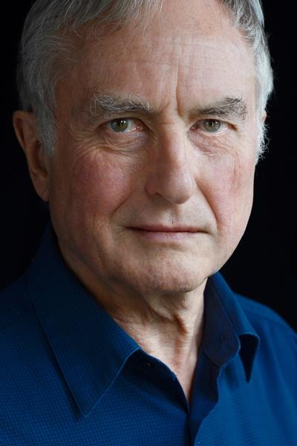
Millions believe…
Earth was seeded by aliens who began the evolutionary process.
Richard Dawkins
Notes:
Who says this?
• Yes, Richard Dawkins!

Slide 4
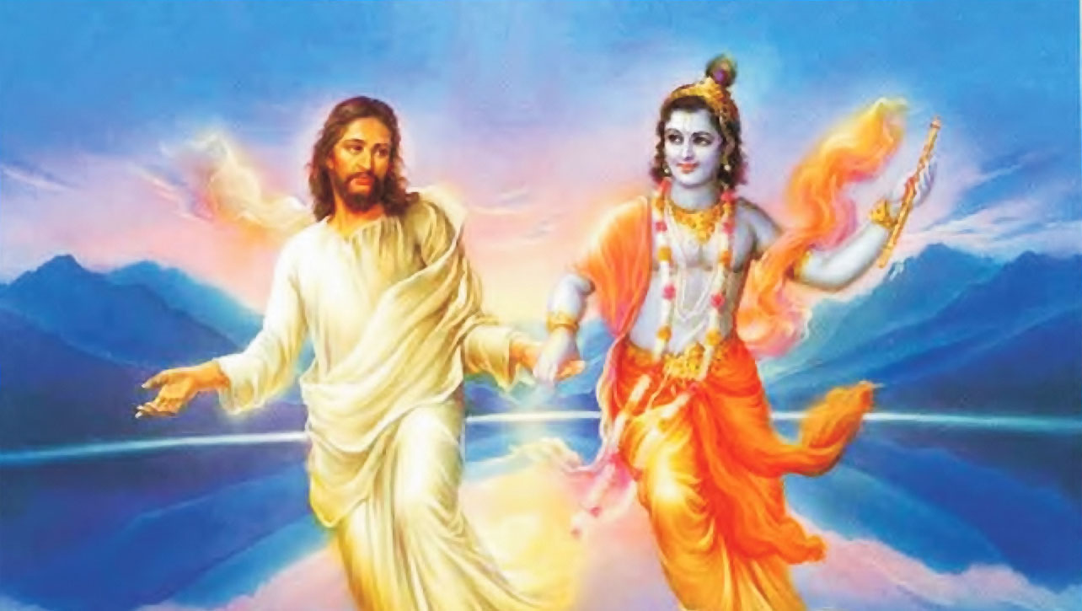
Millions believe…
Jesus went to India to get taught by gurus.
Notes:
No wonder Jesus and Krishna hold hands!

Slide 5
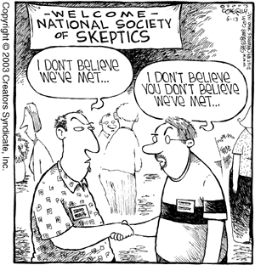
Be skeptical.
Notes:
Millions of people believe the above claims!

Slide 6
Be skeptical.
Notes:
I am a skeptic. You should be too.
Do you believe most of what you are told?
When you get information, do you consider the source?
When people tell you something about Jesus, do you believe it?

Slide 7
How can we be confirmed in our belief in Jesus?
Notes:
What ways can we consider to help us be confident about what we have been taught?

Slide 8
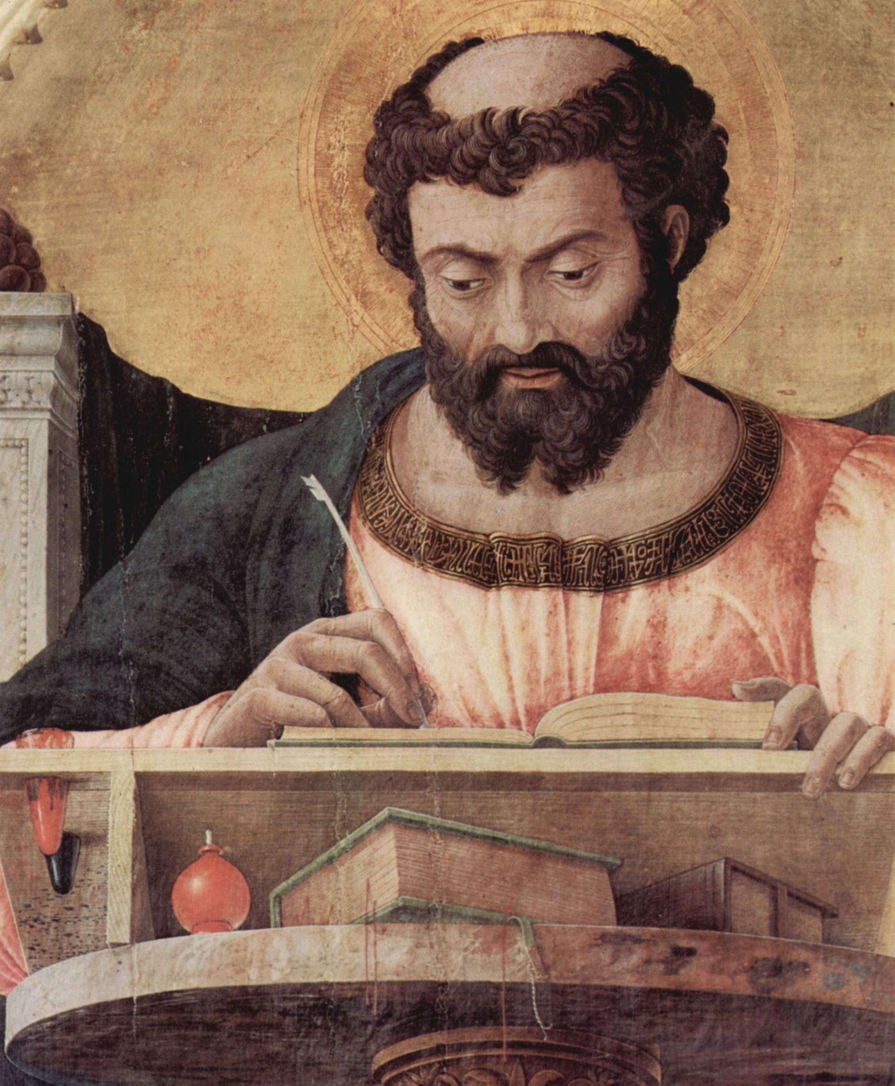
Background
Notes:
Almost 2000 years ago a godly Gentile named Theophilus wanted research to help him see the reliability of the story of Jesus. We also should want to know the reasonableness of what we believe.

Slide 9
Millions believed…
The early church practiced incest
Notes:
Skepticism in the first century was due to rumors.
One rumor was that the early church practiced incest. “After all,” people reasoned, “These Christians even call their spouses a brother or sister in Christ!”

Slide 10
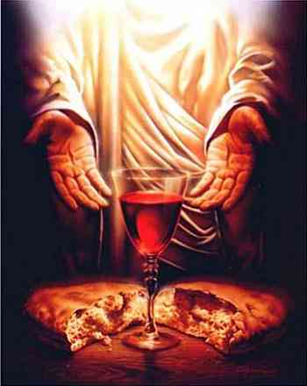
Millions believed…
Early Christians were cannibals
Notes:
Others thought them cannibals. The uninformed watching world said, “Didn’t Jesus say to eat my body and drink my blood?”

Slide 11
NT Overview (Chronological)
38 124 39-41
"To the remotest part of the earth" (Acts 1:8)
Acts 9 13 14 15 16 18 21 27 28
Apr 48- Sep 49
1 Galatia
Apr 50- Sep 52
2 Aegean
Spr 53- May 57
3 Asia
Feb 60- Mar 62
1 Rome
Spr 62- Fall 67
4 Spain
Aut 67- Spr 68
2 Rome
Summer 35- 37
Damascus Antioch
May 57- Aug 59
Trials
Fall 49
The
Council
Spring 68
Expansion of Church
35 48 49 50 52 53 57 60 62 67 68 95
Matt
Gal
1 Thess
1 Cor
James
2 Thess
2 Cor
Missionary
Romans
Gospels & Acts
Pauline Epistles
1234
Journeys
General Epistles
Rome
Imprisonments
Chronological
Notes:
Paul had planted churches throughout the whole eastern part of the Roman Empire. This left the impression with some westerners that Christianity was only an eastern religion.
Paul had written six inspired letters on his three mission trips from Antioch to Greece.
By this time, the Jews had the gospel of Matthew that was directed towards Jewish readers. Matthew gave evidences for Jesus as the long-awaited Messiah, or ruler promised in the OT.

Slide 12
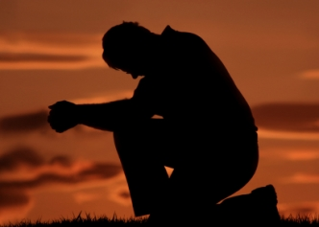
Romans 15:14-19
Paul wrote the Romans…
“I have fully presented the Good News of Christ from Jerusalem all the way to Illyricum” (Romans 15:19).

Slide 13
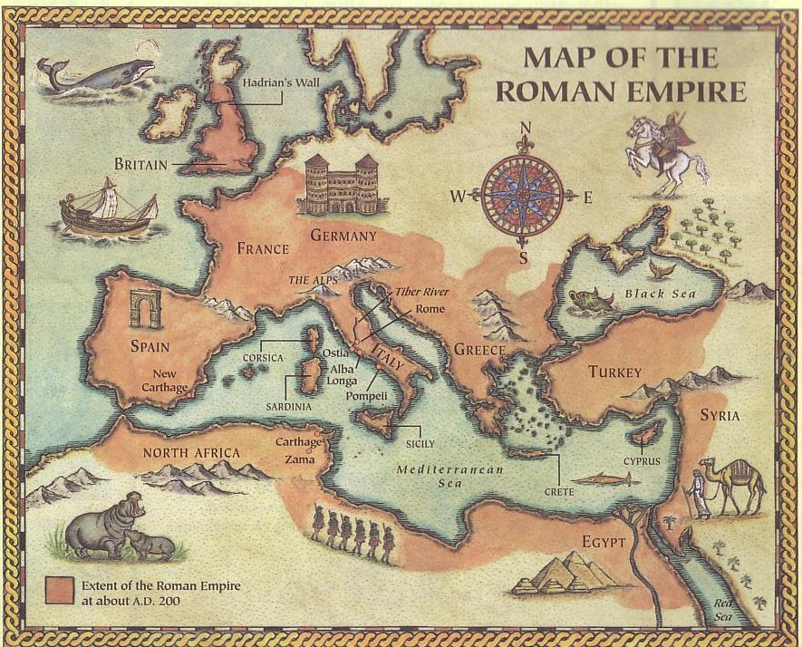
Paul's Ministry Westwards
Illyricum
Rome
Jerusalem
Notes:
Jerusalem to Illyricum represented the eastern part of the Empire. No wonder many Gentiles thought that Christians were easterners following an eastern, Jewish Jesus!

Slide 14
“Christianity is a Western Religion”
Is that true?
Notes:
Today the opposite is claimed—that Christianity is a Western Religion.

Slide 15
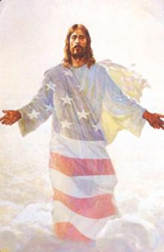
The Question of Luke's Readers: Can this easterner (Jesus) be the Savior of a westerner like me (a Gentile)?
Why do people think Christianity is a western religion?
Jesus was not an American!

Slide 16
NT Overview (History)
38 124 39-41
"To the remotest part of the earth" (Acts 1:8)
Acts 9 13 14 15 16 18 21 27 28
Apr 48- Sep 49
1 Galatia
Apr 50- Sep 52
2 Aegean
Spr 53- May 57
3 Asia
Feb 60- Mar 62
1 Rome
Spr 62- Fall 67
4 Spain
Aut 67- Spr 68
2 Rome
Summer 35- 37
Damascus Antioch
May 57- Aug 59
Trials
Fall 49
The
Council
Spring 68
Expansion of Church
35 48 49 50 52 53 57 60 62 67 68 95
Matt
Luke
Date
The Book of Acts ends with Paul's two year imprisonment,
ending in AD 62, and Luke was written before Acts. The best estimate is probably that Luke wrote his account during Paul's two-year imprisonment at Caesarea (Jun 57-Aug 59).
Gospels & Acts
1234
Journeys
Rome
Imprisonments
Gospels & Acts
Notes:
By this time, the Jews had the gospel of Matthew that was directed towards Jewish readers. Matthew gave evidences for Jesus as the long-awaited Messiah, or ruler promised in the OT. But now after the East was reached was the time for Luke to present Jesus to the westerners. Paul was awaiting trial for two years in Israel. Luke was with him and in the perfect time and place to write a history of Jesus for Gentiles.

Slide 17
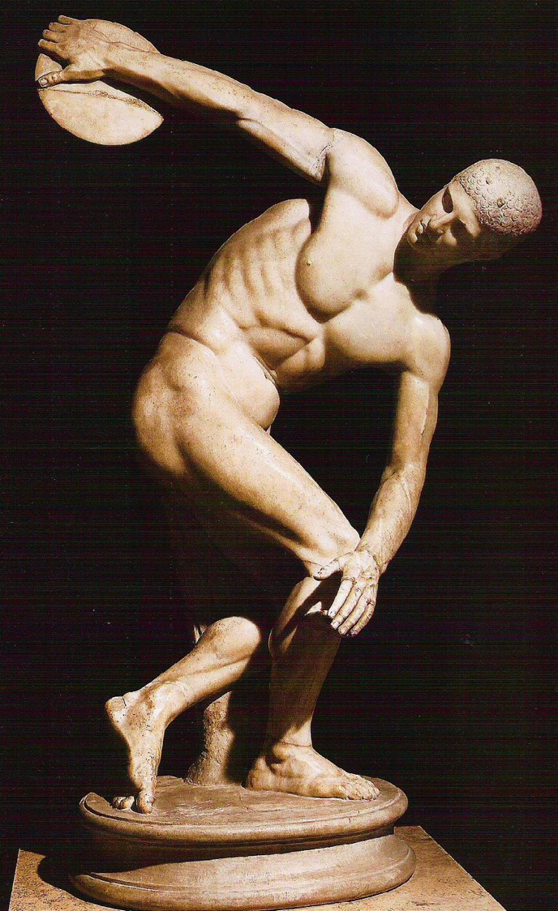
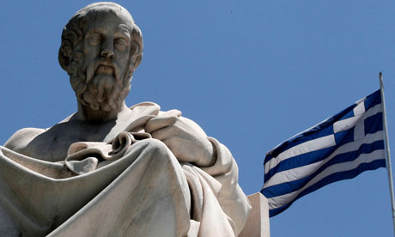
Greeks idealized the "Perfect Man"
Notes:
Yet there was no corresponding gospel written for a Gentile audience. Who could write an account of the life of Christ for this even larger group that had no OT background? Gentiles are less nationalistic, more philosophical, and especially needed evidence how this “eastern Savior” impacted them.

Slide 18
Men aren't perfect either
Waiting…
for the perfect man.
Notes:
Even today some ladies are waiting for the perfect man. Well, wait no longer!

Slide 19
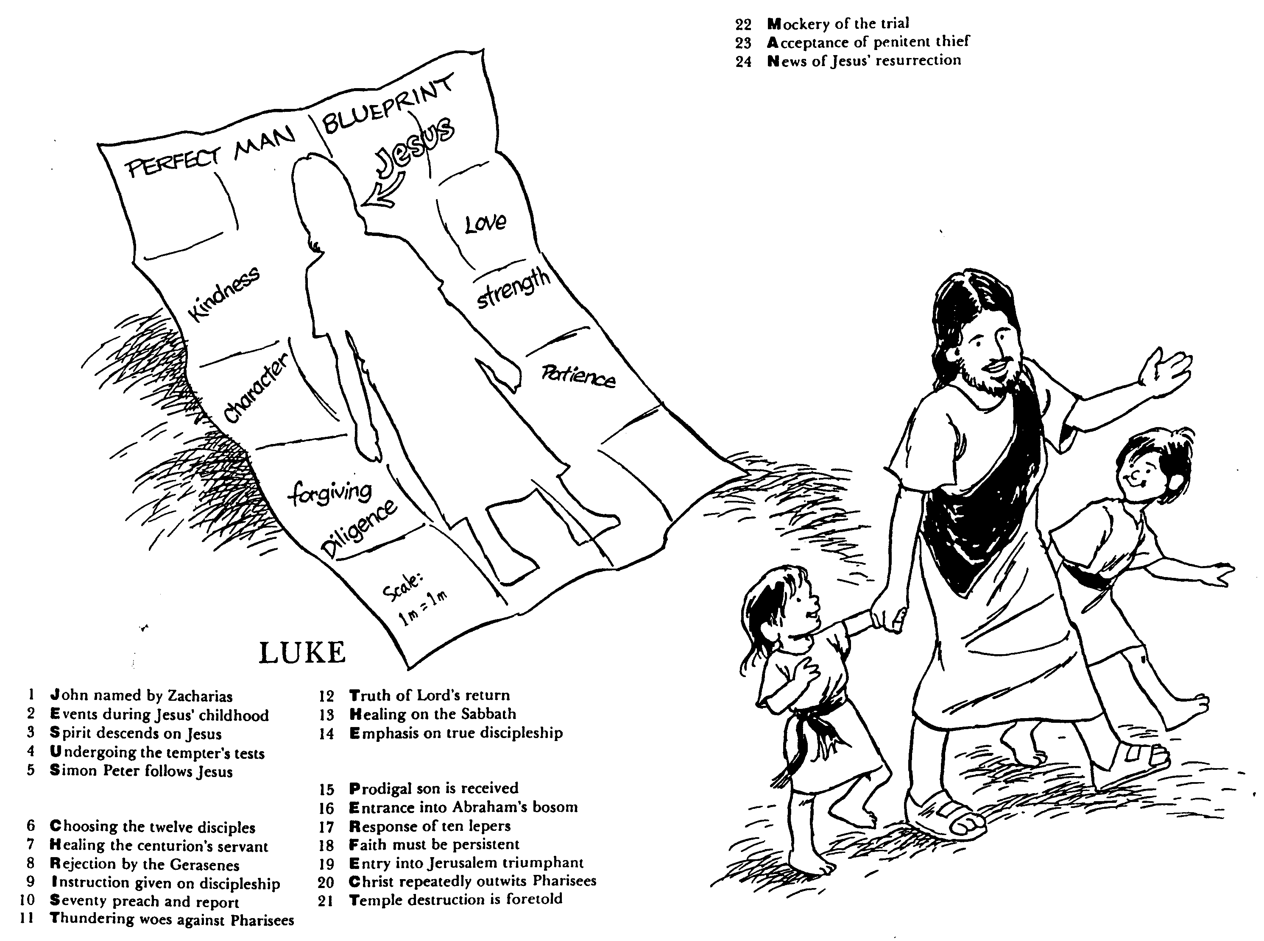
The perfect man is Jesus!
PELAN SEORANG LELAKI SEMPURNA
Yesus
Kasih
Baik Hati
Kekuatan
Karakter
Sabar
Ampun
Rajin
Skala
Luke

Slide 20
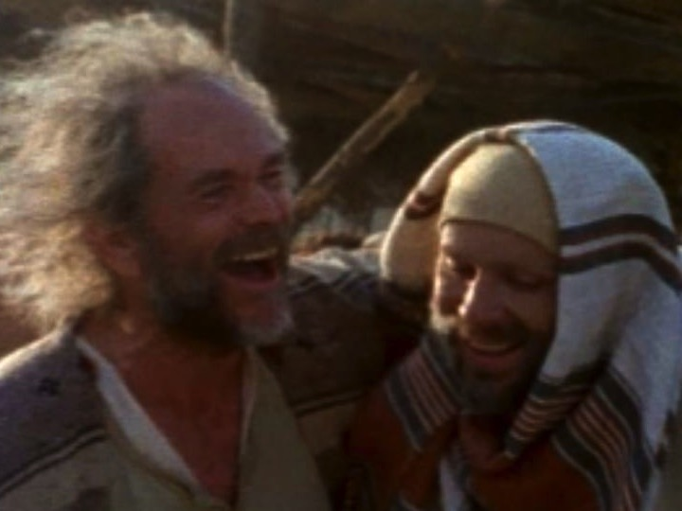
Who was Luke?
Medical doctor
Traveling companion of Paul
Articulate historian & writer
Notes:
Enter Dr Luke. A detailed man, medical doctor, and single man, Luke was ideally suited to write this account. He also had traveled with Paul on his journeys and, as a Gentile himself, he knew the Gentile mind.

Slide 21
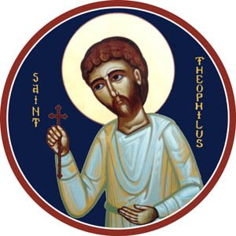
Who was Theophilus?
“One who loves God”
Believer in Jesus
Probably a Wealthy Benefactor
Notes:
Who was Theophilus? His name means “one who loves God".” As a believer, he likely funded Luke’s travel and research for this gospel.

Slide 22
Where did the writer and readers live?
Rome?
LUKE
69
Asia Minor?
Origin: Caesarea, Israel
Destination: Theophilus
Caesarea
Alexandria?
Notes:
But how could Luke get the time to write when they were so busy traveling?
Paul had just finished his third missionary journey with the plan to briefly return to Jerusalem with the Gentile offering for the Jewish saints (cf. Rom 15).
However, a riot in Jerusalem led to his arrest and imprisonment in Caesarea for two years (Acts 21). Paul was in jail, but Luke was not during AD 57-59. Based from the Roman headquarters in Israel called Caesarea, it was the ideal time and place for Luke to travel around Israel for his research. Jesus had lived there only 25 years earlier, so many people would be available to interview—as would be the case if you were to write a book about events 25 years ago.

Slide 23
How can we be confirmed in our belief in Jesus?
Notes:
What ways can we consider to help us be confident about what we have been taught?

Slide 24
Slides on Luke 1

Slide 25
How to be confirmed…
…in our belief in Jesus
Sources about Christ’s life are reliable (1:1-4).
Notes:
Luke’s sources were credible for skeptical Gentiles and to achieve his purpose to confirm the faith of Theophilus

Slide 26
¹Many people have set out to write accounts about the events that have been fulfilled among us. ² They used the eyewitness reports circulating among us from the early disciples.
Luke 1:1-2 (NLT)

Slide 27
³ Having carefully investigated everything from the beginning, I also have decided to write an accurate account for you, most honorable Theophilus, ⁴ so you can be certain of the truth of everything you were taught.
Luke 1:3-4 (NLT)

Slide 28
How to be confirmed…
…in our belief in Jesus
God sent Jesus to be both Jewish and the universal Saviour (1:5–4:13).
Sources about Christ’s life are reliable (1:1-4).
Notes:
Christ’s pre-public life in his advent and ministry preparation shows God's orderly and sovereignly directed plan in a Semitic context but with universal overtones.
Christ’s advent in the infancy narratives of John and Jesus shows God sovereignly provided Jesus as Israel’s Messiah, the world’s Savior, and the Son of God (1:5–2:52).

Slide 29
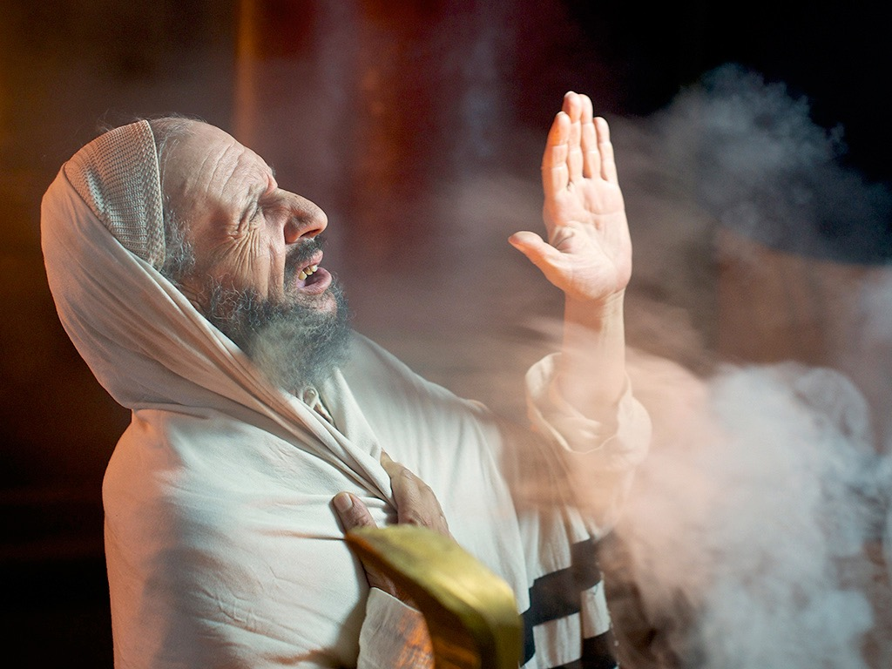
Luke 1:5-25, 39-45, 57-80
ZECHARIAH IS PROMISED A SON
Free Bible images
Notes:
The announcements of the births of John and Jesus reveal in their Old Testament allusions that Jesus is truly Israel’s Messiah (1:5-56).

Slide 30
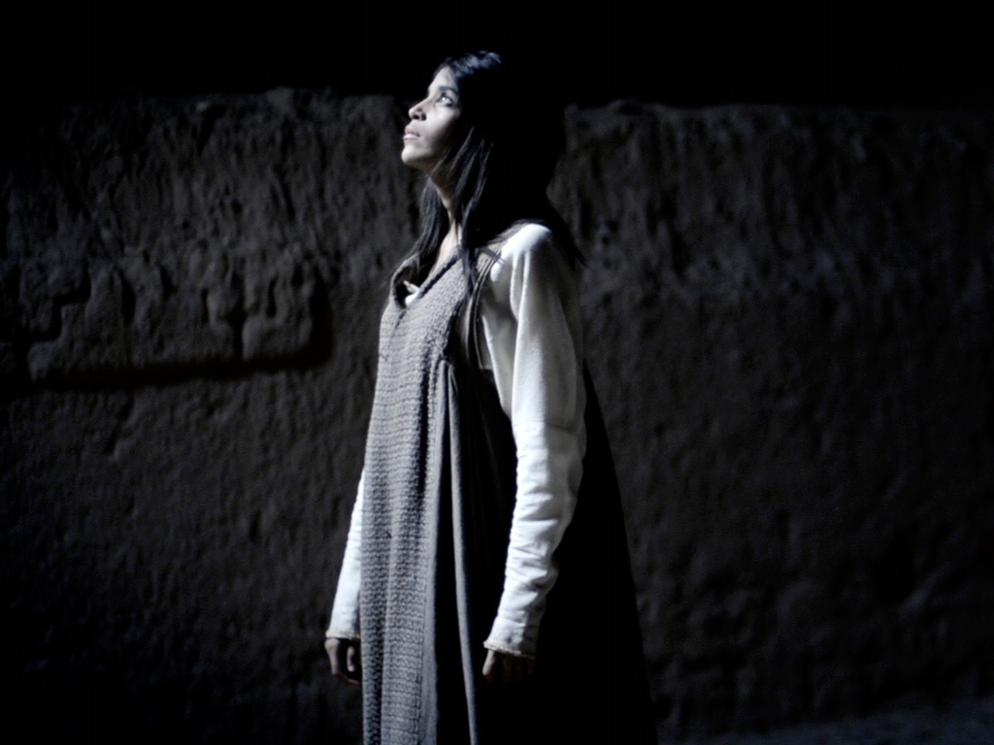
AN ANGEL VISITS MARY
Free Bible images
Luke 1:26-38
Notes:
Miraculous births of John and Jesus show that God controls all things—from barren women to the dictates of kings—to give Israel’s Messiah to the world (1:57–2:20).

Slide 31
"HE WILL REIGN OVER THE THRONE OF JACOB FOREVER, AND OF HIS KINGDOM THERE WILL BE NO END" (LUKE 1:33)

Slide 32
Slides on Luke 2

Slide 33
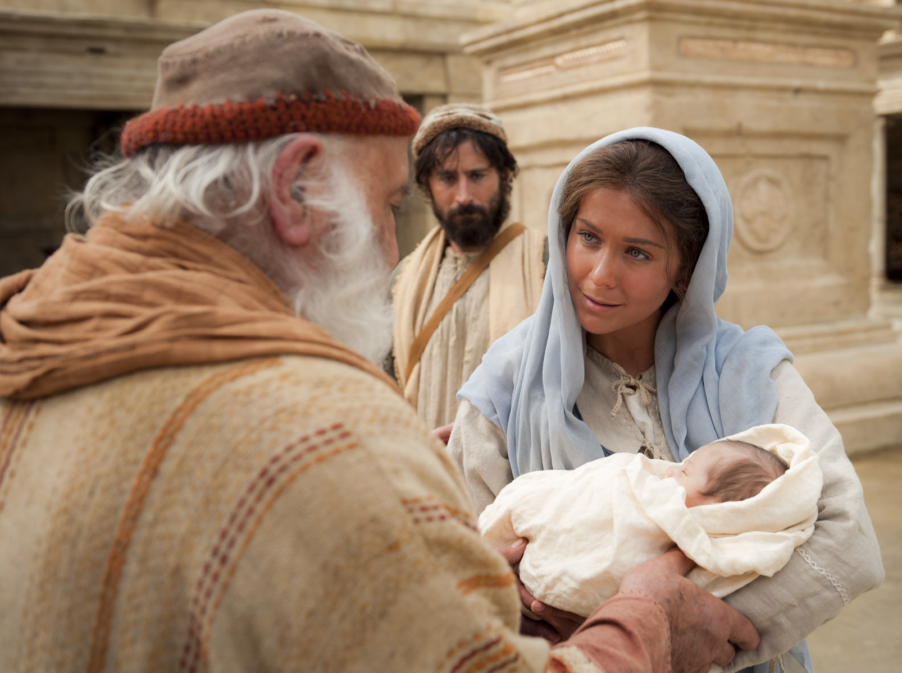
"Sovereign Lord, now let your servant die in peace, as you have promised. ³⁰I have seen your salvation, ³¹which you have prepared for all people. ³²He is a light to reveal God to the nations [Gentiles], and he is the glory of your people Israel!" (Luke 2:29-32 NLT).
Notes:
Here we see the universal appeal of the gospel in Luke. Luke clearly has Gentiles in mind, for he translates Aramaic terms, traces Christ's genealogy back to Adam, refers to Roman rulers for dating, avoids mentioning fulfillment of prophecies, quotes the Septuagint, and explains Jewish customs and Israel’s geography.

Slide 34
Dating the Birth of Christ
56
Date of Birth: ca. December 5 BC/January 4 BC
Jesus was born between these two dates:
Census of Quirinius/Cyrenius (Luke 2:1-5)
Death of Herod the Great (Matt. 2:1; Luke 1:5)
6 BC
29 March-11 April
4 BC
Harold W. Hoehner, Chronological Aspects of the Life of Christ (Zondervan, 1977), 114

Slide 35
Slides on Luke 3

Slide 36
John the Baptist
Luke
3:1-2
In the fifteenth year of the reign of Tiberius Caesar, Pontius Pilate being governor of Judea, and Herod being tetrarch of Galilee, and his brother Philip tetrarch of the region of Ituraea and Trachonitis, and Lysanias tetrarch of Abilene,
in the high-priesthood of Annas and Caiaphas, the word of God came to John the son of Zechariah in the wilderness;

Slide 37
John the Baptist
Luke
3:3-4
and he went into all the region about the Jordan, preaching a baptism of repentance for the forgiveness of sins.
As it is written in the book of the words of Isaiah the prophet, "The voice of one crying in the wilderness: Prepare the way of the Lord, make his paths straight.

Slide 38
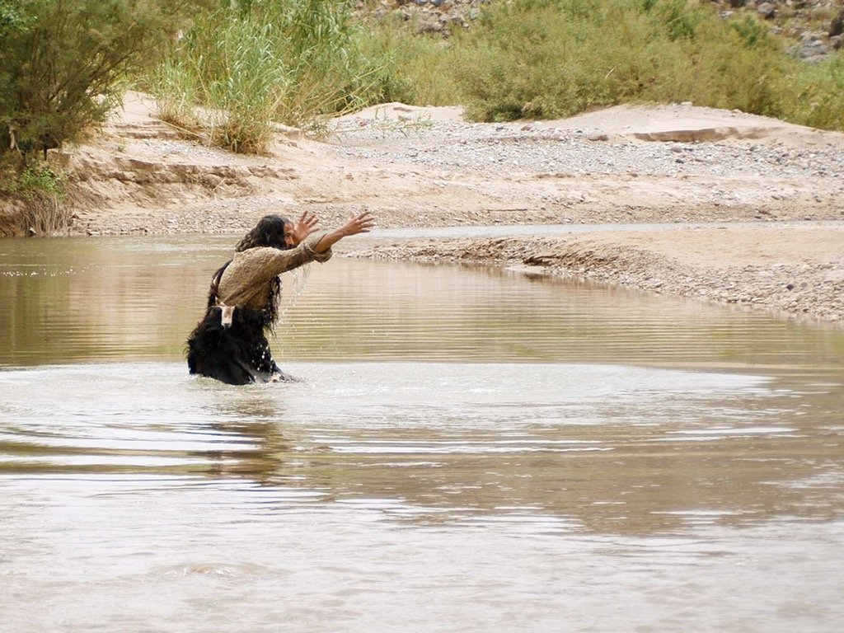
JOHN THE BAPTIST
Matthew 3:1-16
Mark 1:1-11
Luke 3:1-22
John 1:1-34
Free Bible images

Slide 39
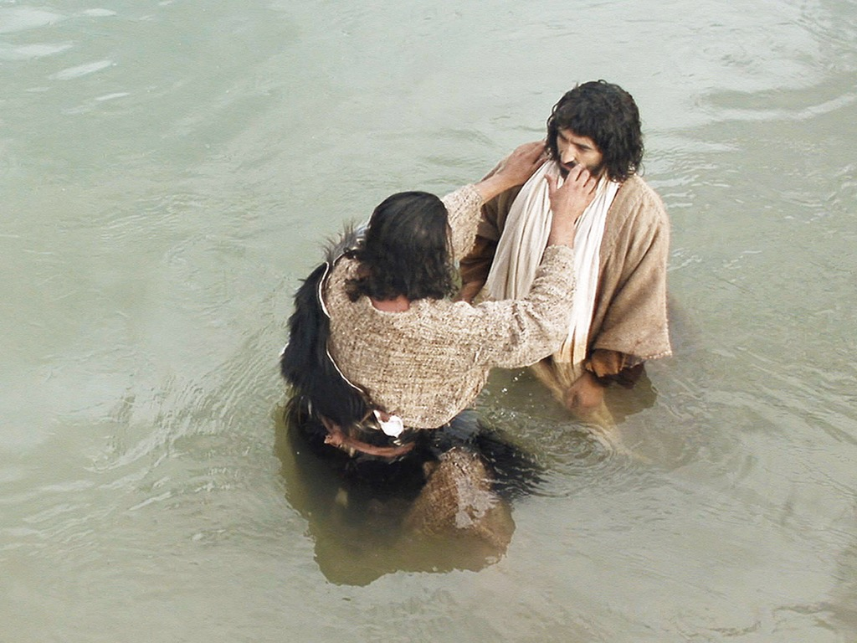

Slide 40
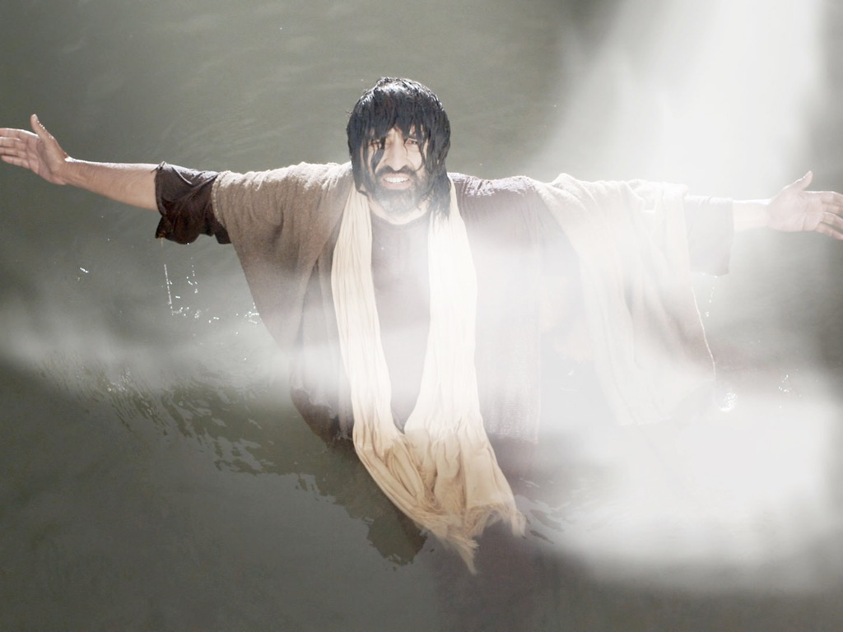

Slide 41
Chronology of Jesus in Luke
38a
4 BC
1 BC
AD 1
14
29
30
33
35
Jesus Born
–1 year–
Tiberius Crowned
15th Yr. Tiberius
– John & Jesus
Jesus Died
Paul Believed
"In the 15th year of Tiberius… John preached" (Luke 3:1)
32-33 years
"Now Jesus himself was about 30 years old when he began his ministry" (Luke 3:23)

Slide 42
THE LINE OF DAVID: The Royal Genealogy of Jesus Christ*
101a
ADAM EVE
CAIN ABEL SETH
NOAH
ABRAHAM
DAVID BATHSHEBA
NATHAN SOLOMON
The FAMILY Right
Luke 3:23-38
The LEGAL Right
Matt 1:1-17
BLOOD
RIGHT
LEGAL
RIGHT
MARY JOSEPH
JESUS CHRIST
37
Notes:
...and Joseph…as the foster-father and a descendant of King Solomon… has the right of legal succession to bestow upon his foster son, Jesus. A remarkable evidence of the credibility and reliability of the Scriptural record.

Slide 43
Slides on Luke 4
Notes:
Christ's temptation by Satan records his refusal to gain people's acceptance without the cross as an example of waiting upon God's plan to save the world (4:1-13).

Slide 44
How to be confirmed…
…in our belief in Jesus
God’s plan included Jewish rejection of Jesus to offer salvation to Gentiles (4:14–21:38).
God sent Jesus to be both Jewish and the universal Saviour (1:5–4:13).
Sources about Christ’s life are reliable (1:1-4).
Notes:
The Galilean ministry and route to Jerusalem show Israel rejecting Jesus as Messiah and his judgment by turning to Gentiles in the times of the Gentiles.

Slide 45
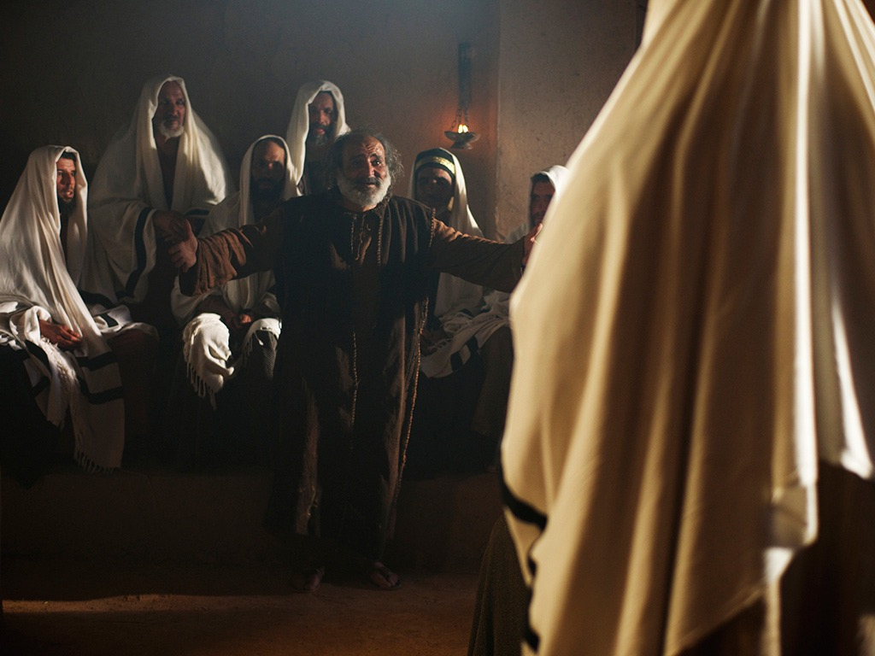
Free Bible images
Mark 1:21-28; Luke 4:31-37
JESUS DELIVERS A POSSESSED MAN
Notes:
Christ's ministry in Galilee is the first stage of Jewish rejection despite his miracles to prove he is Messiah in contrast to reception by Gentiles and his disciples (4:14–9:50).
Gentiles accepting Jesus in Galilee contrasts with Jewish rejection in Nazareth to foretell Jewish unbelief and Gentile reception to fulfill OT prophecy (4:14-30).

Slide 46
Slides on Luke 5

Slide 47
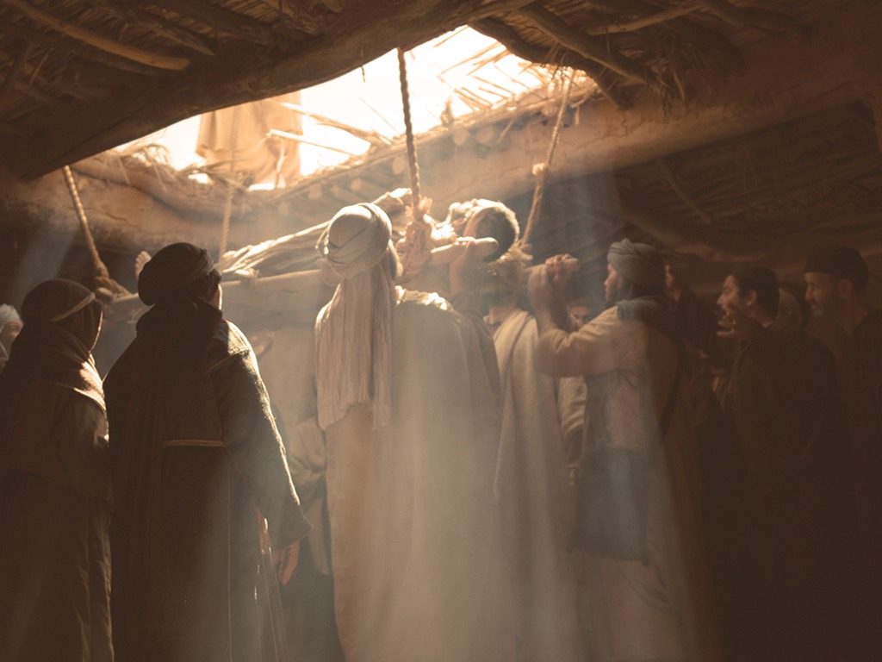
Free Bible images
Mark 2:2-12; Luke 5:17-26
JESUS FORGIVES AND HEALS A PARALYZED MAN

Slide 48
Slides on Luke 8
Notes:
Christ's ministry to needs in and near Capernaum chronicles the kingdom expansion through his miracles and teaching to further show his identity as Messiah (Luke 7–8).

Slide 49
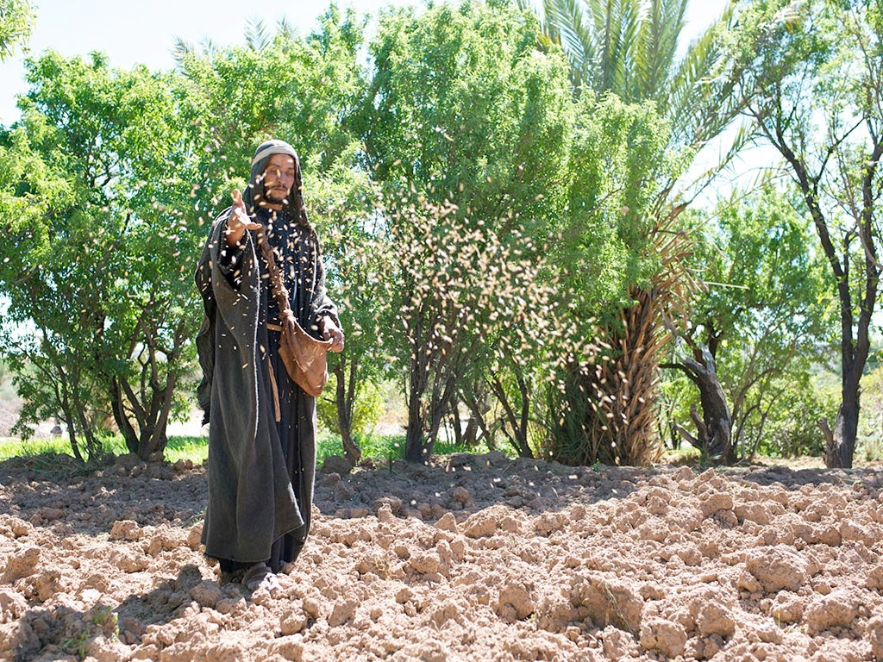
Free Bible images
Matthew 13:1-23; Mark 4:1-20; Luke 8:1-15
PARABLE OF THE SOWER

Slide 50
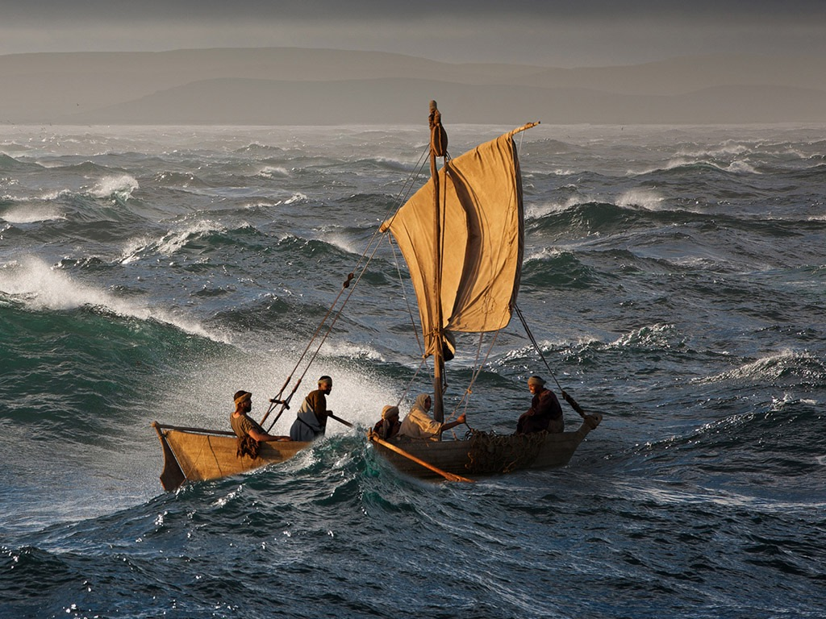
Free Bible images
Matthew 8:23-27
Mark 4:35-41 Luke 8:22-25
JESUS CALMS A STORM

Slide 51
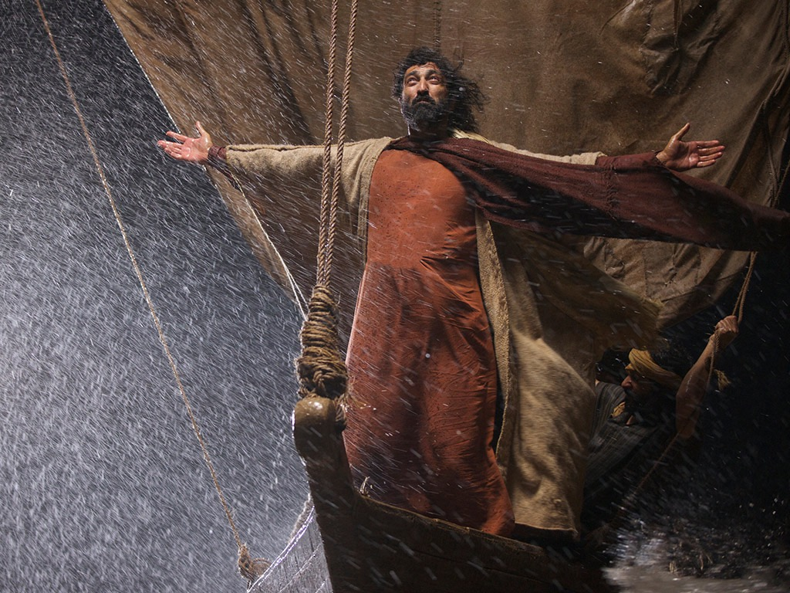

Slide 52
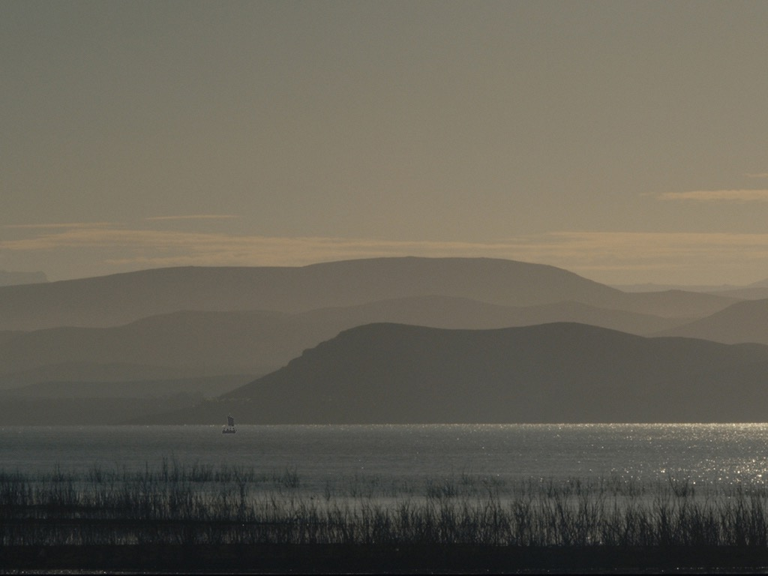

Slide 53
Slides on Luke 9
Notes:
Christ's teaching dependence upon himself to his disciples climaxes his Galilean ministry before he begins to approach Jerusalem (9:1-50).

Slide 54
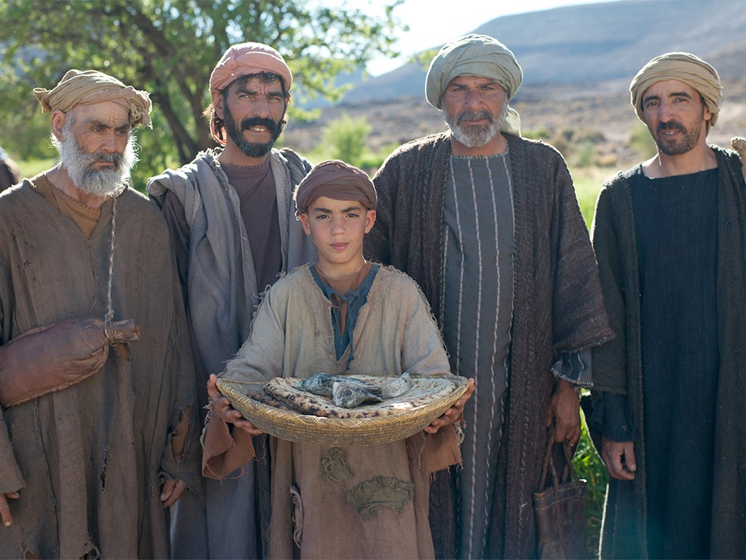
JESUS FEEDS 5000
Free Bible images
Matthew 14:13-22
Mark 6:31-46
Luke 9:10-17
John 6:1-13

Slide 55
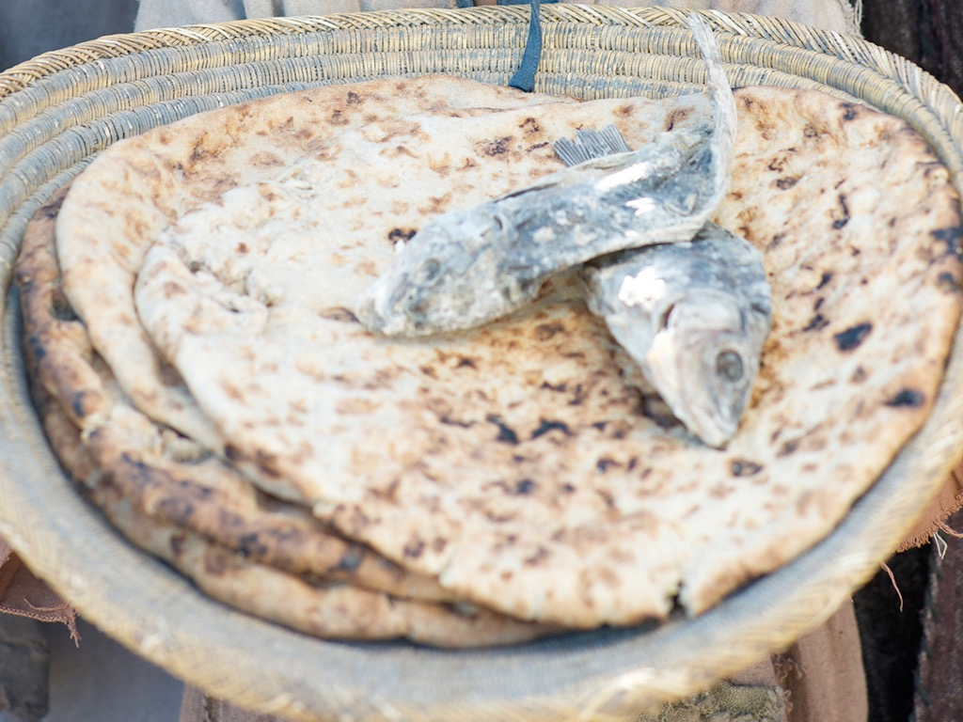

Slide 56
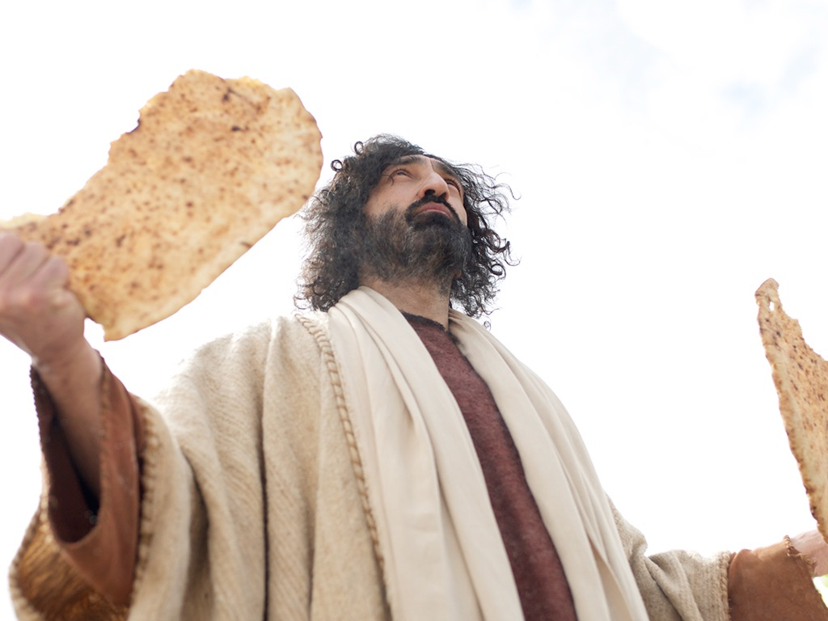

Slide 57
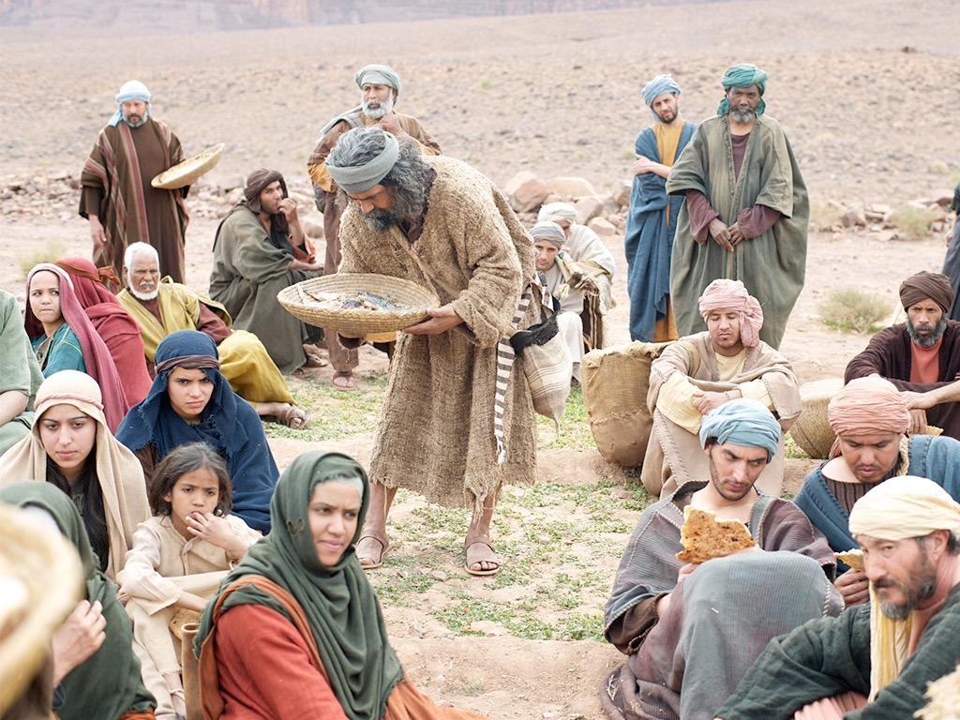

Slide 58
Slides on Luke 10

Slide 59
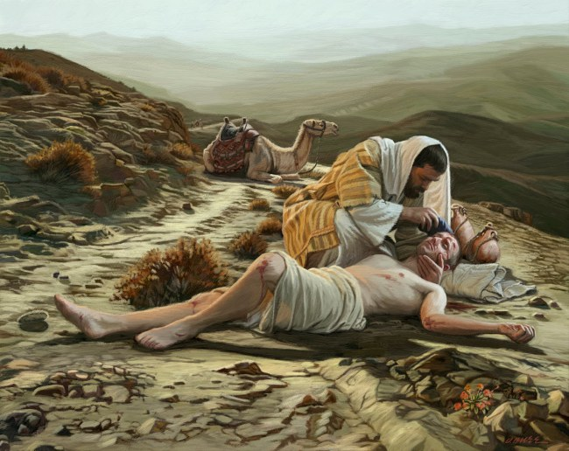
God's Compassion
Luke 10:25-37

Slide 60
Slides on Luke 15

Slide 61
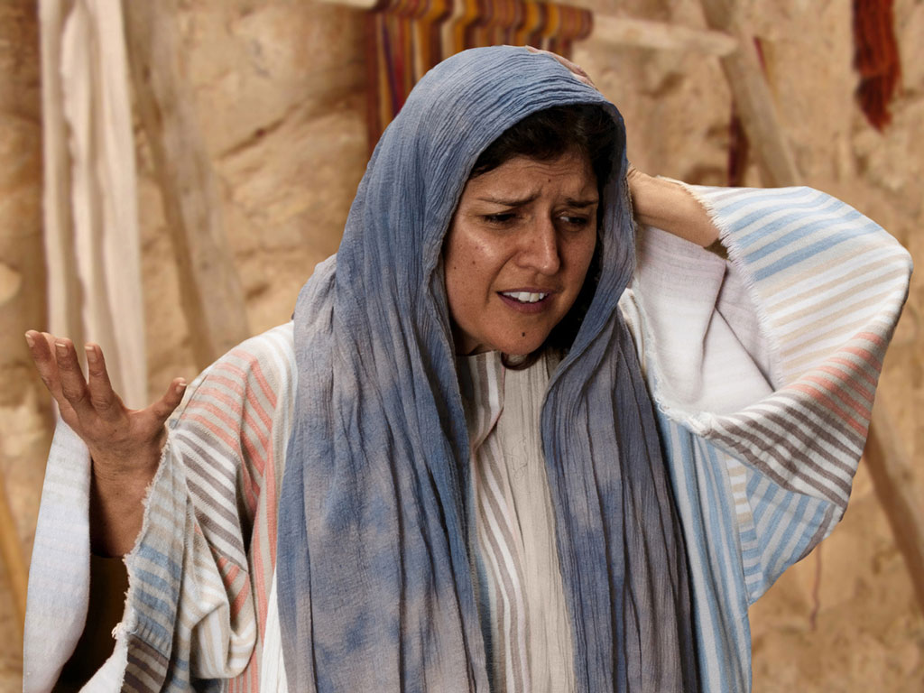
Free Bible images
THE PARABLE OF THE LOST COIN
Luke 15:8-10
Notes:
Luke's gospel is known for its many parables by Jesus.

Slide 62
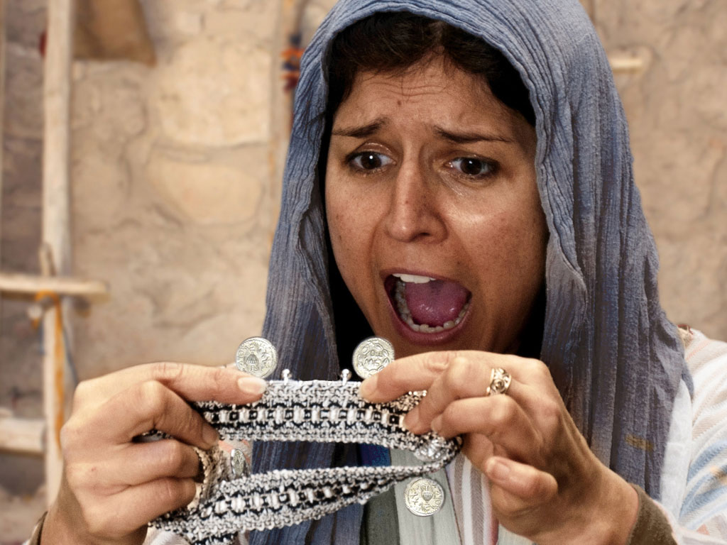
Notes:
Luke 15 v 8: Woman discovers a silver coin is missing.

Slide 63
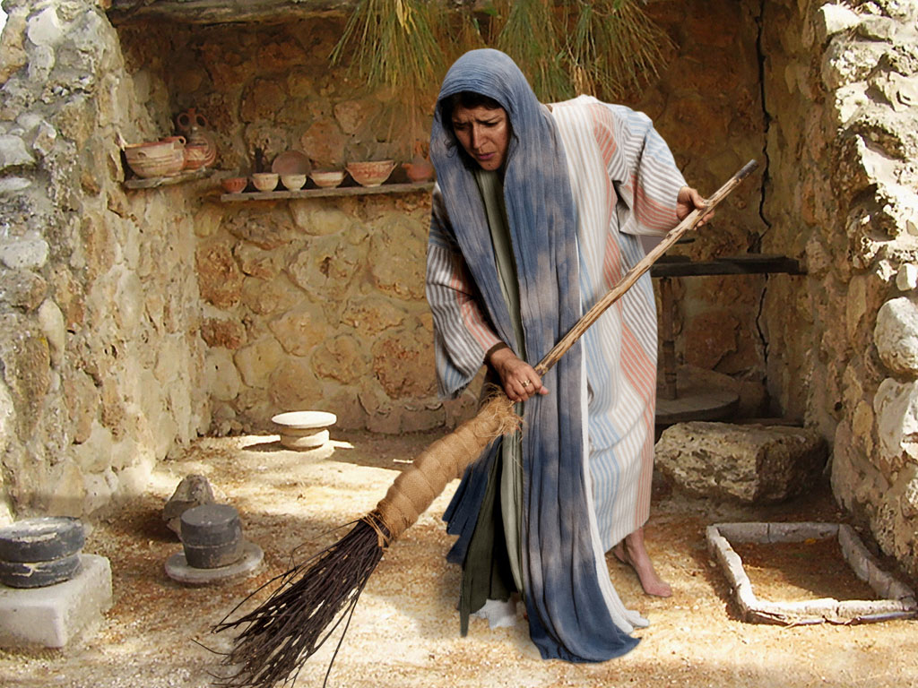
Notes:
Luke 15 v 8: Woman searches using broom.

Slide 64
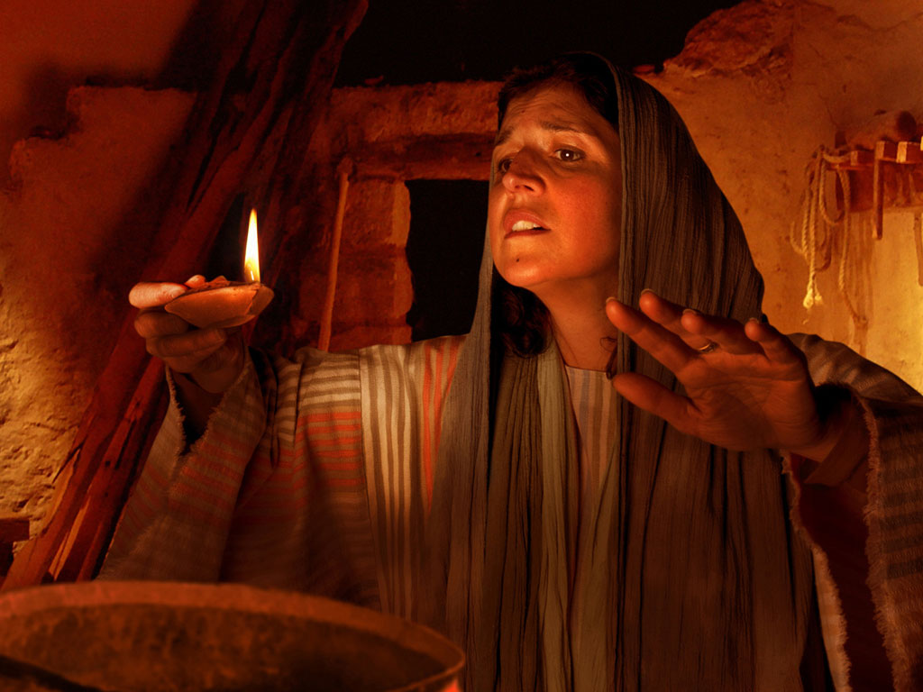
Notes:
Luke 15 v 8: Woman searches house by lamp light.

Slide 65
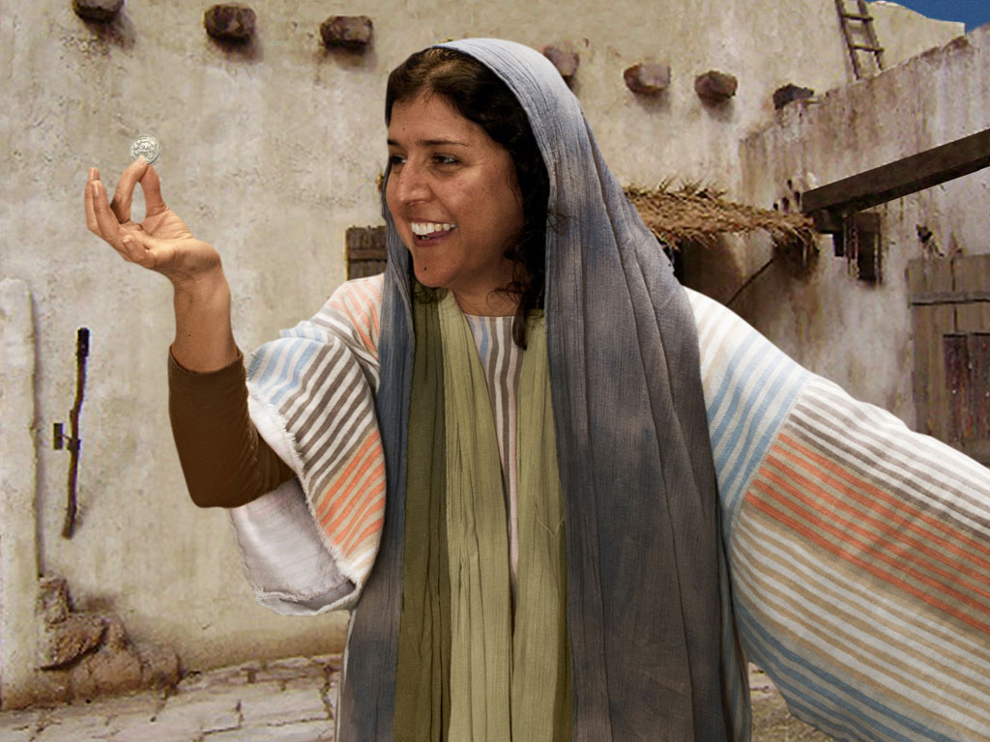
Notes:
Luke 15 v 9: Woman is full of joy as she finds coin.

Slide 66
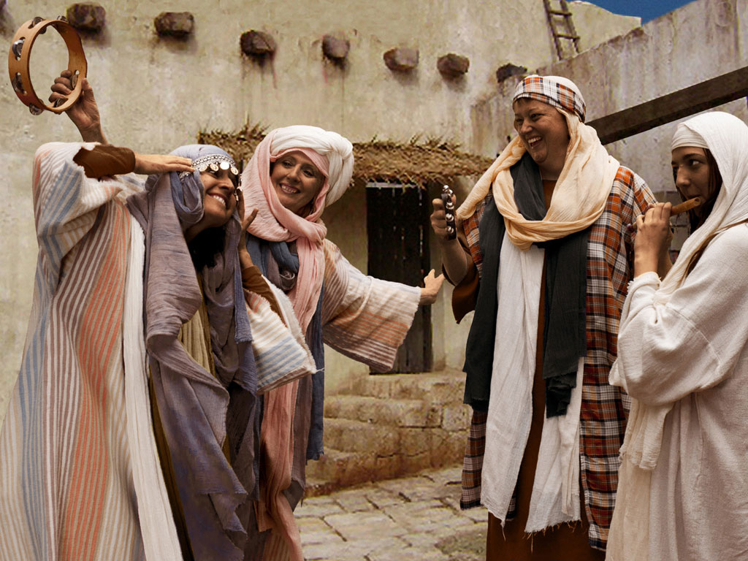
Notes:
Luke 15 v 9: Woman celebrates her good news with neighbours and friends. 'Rejoice with me; I have found my lost coin.'

Slide 67
Luke 15:7
Just so, I tell you, there will be more joy in heaven over ONE SINNER WHO REPENTS than over 99 righteous persons who need no repentance.
Adapted from Logos Bible Software

Slide 68
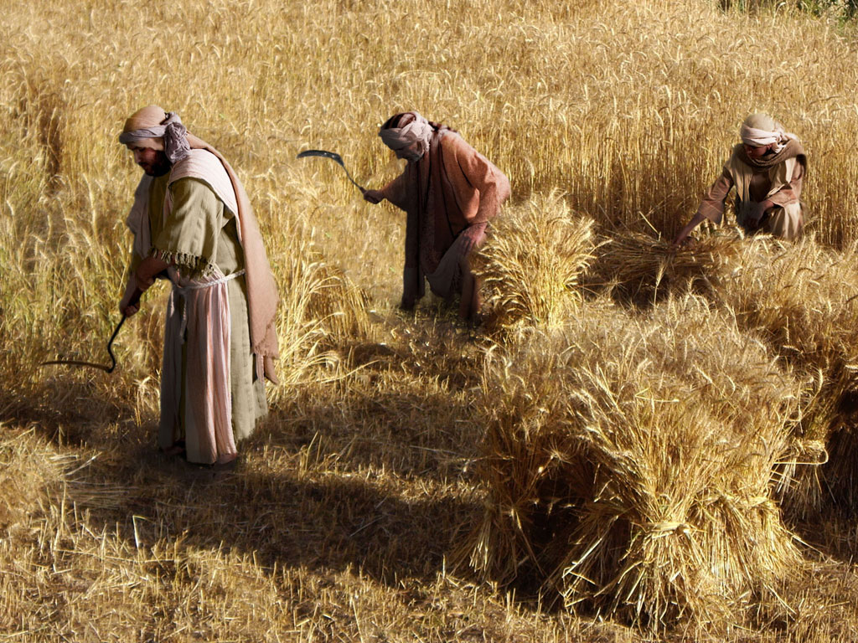
THE PARABLE OF THE TWO SONS (Prodigal Son)
Free Bible images
Luke 15:11-32

Slide 69
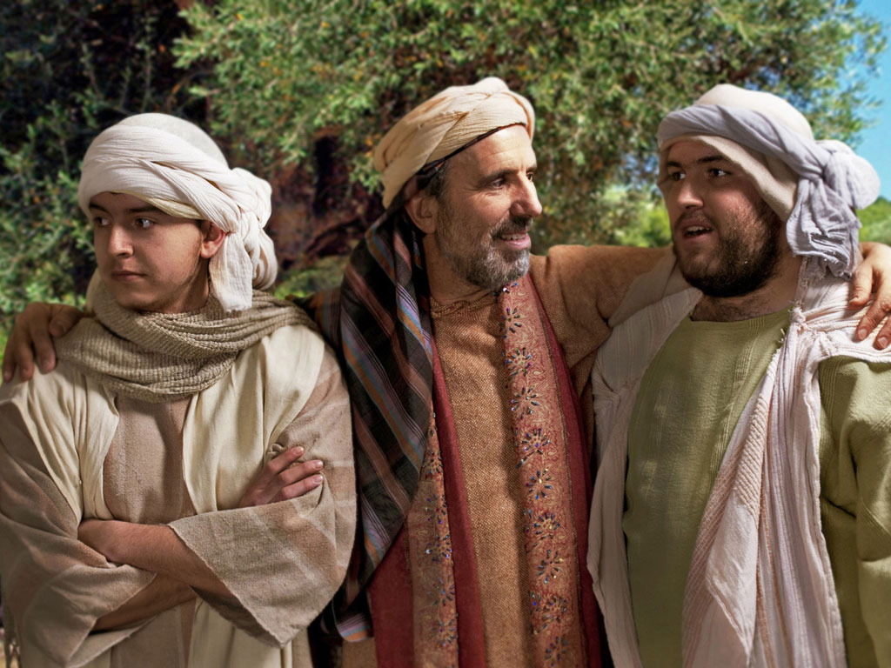

Slide 70
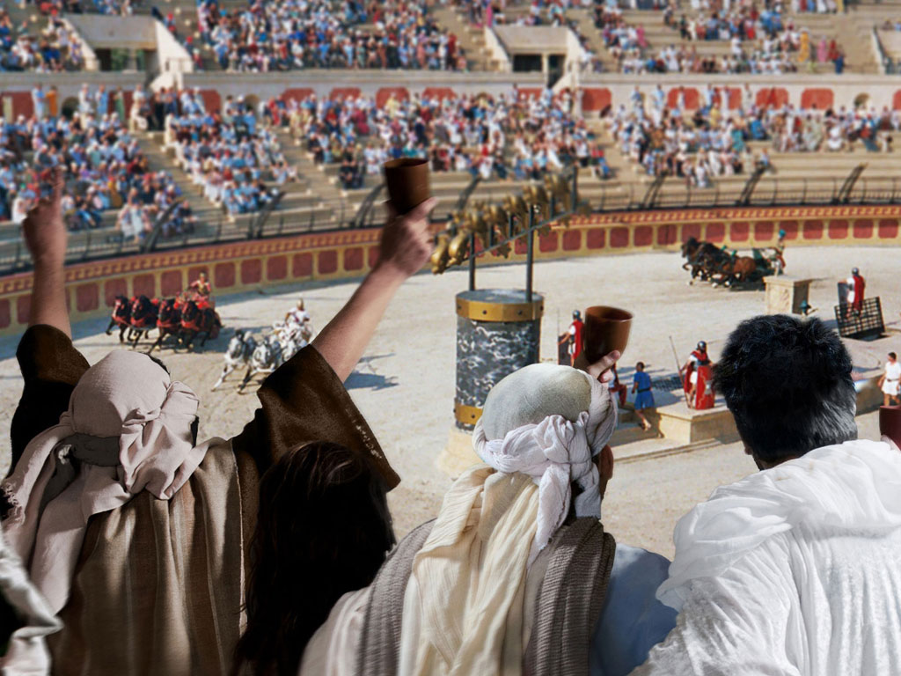

Slide 71
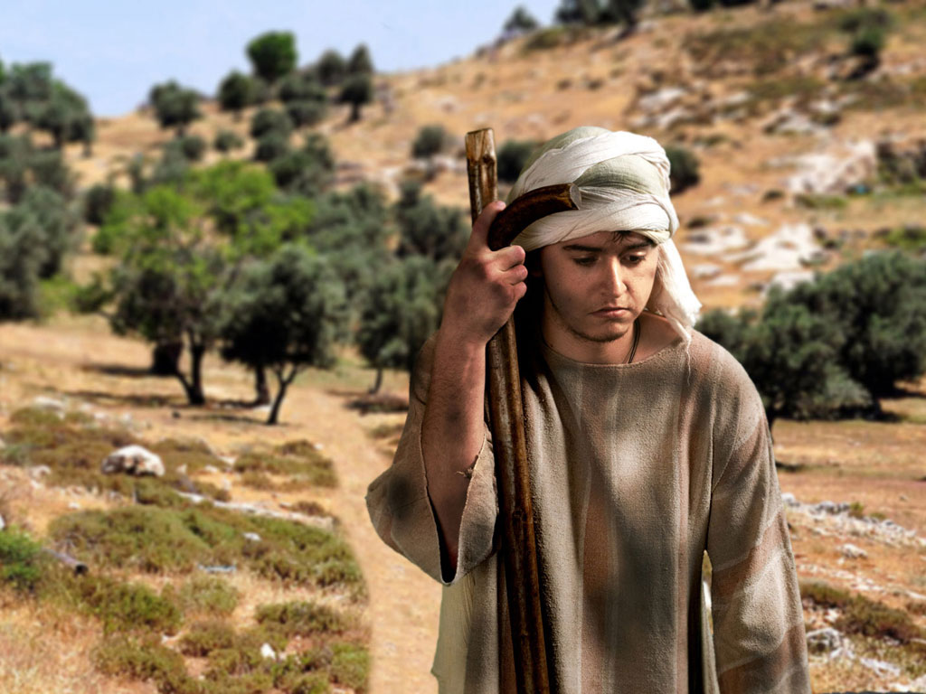

Slide 72
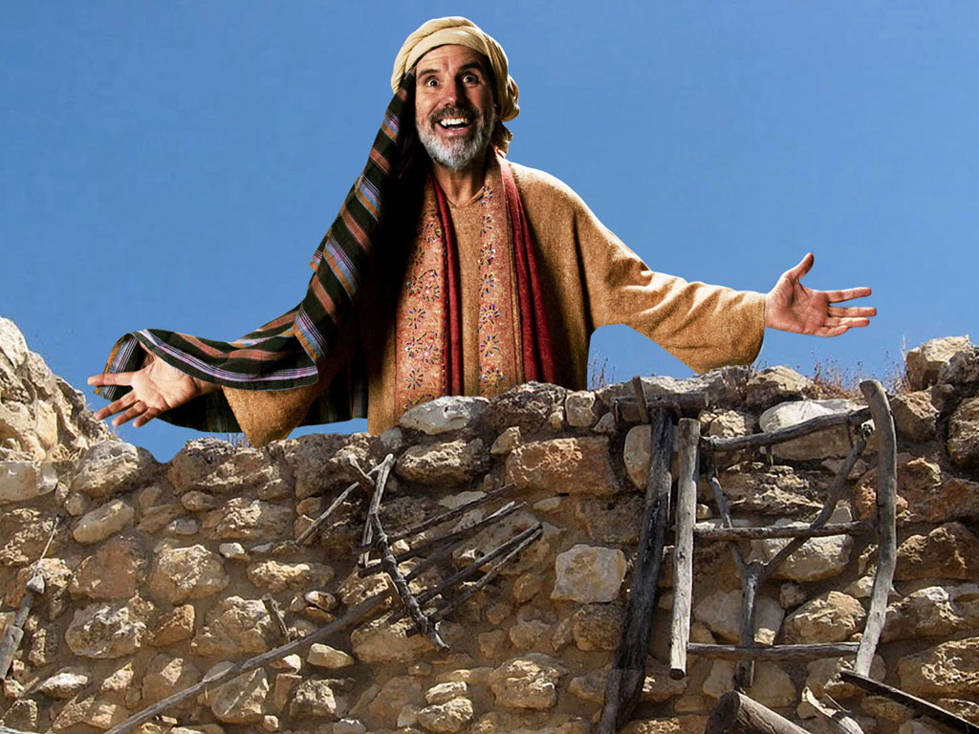

Slide 73
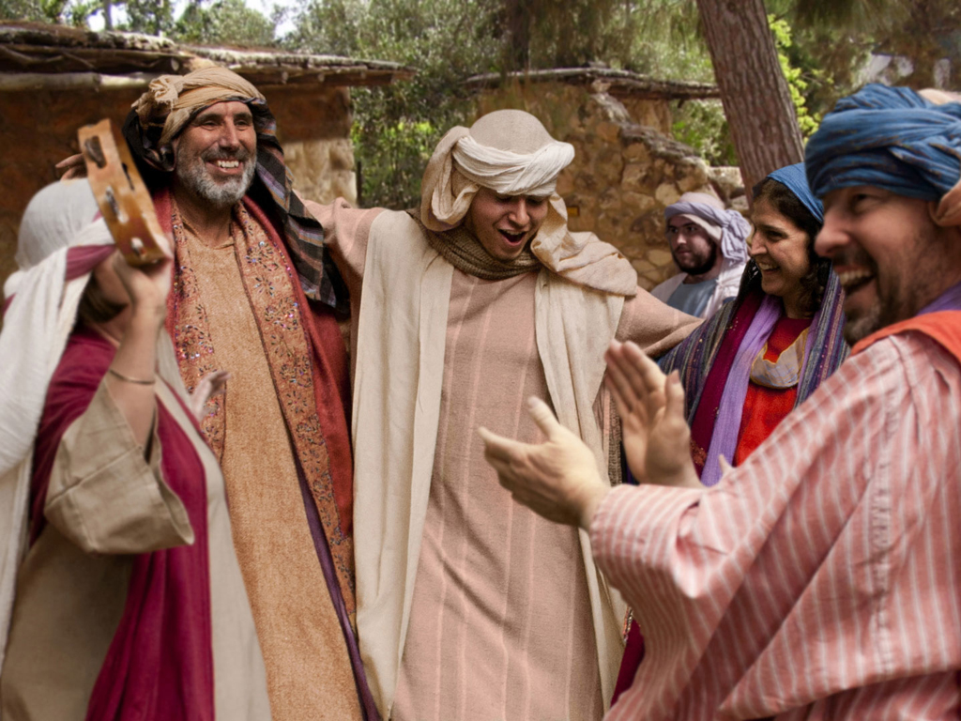

Slide 74
Slides on Luke 19

Slide 75
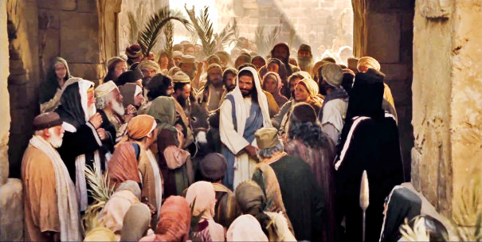
Triumphal Entry
Notes:
True, Jesus rode into Jesus and the crowds cheered his arrival.

Slide 76
Triumphant Entry
Matthew 21:9
Notes:
Matthew 21:9 says the crowds that went ahead of him and those that followed shouted, "Hosanna to the Song of David!" "Blessed is he who comes in the name of the Lord!" "Hosanna in the highest!"

Slide 77
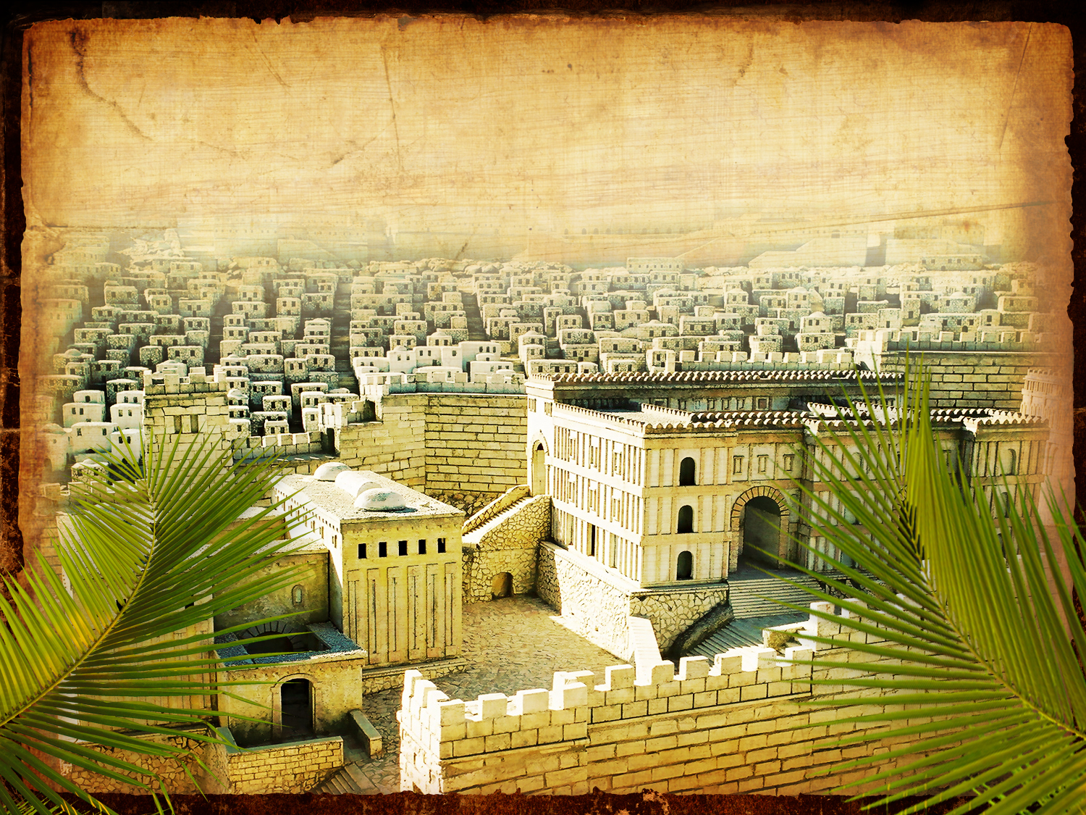
An Ominous Day: Luke 19:41-42 NAU
"When He approached Jerusalem, He saw the city and wept over it, ⁴²saying, 'If you had known in this day, even you, the things which make for peace! But now they have been hidden from your eyes.'"

Slide 78
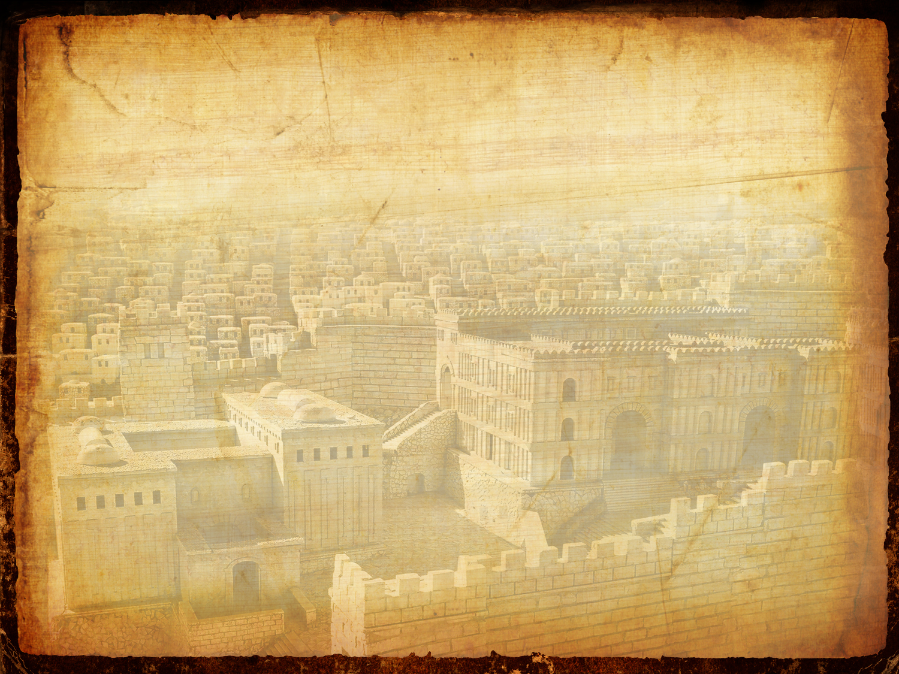
An Ominous Day: Luke 19:43-44 NAU
"For the days will come upon you when your enemies will throw up a barricade against you, and surround you and hem you in on every side, ⁴⁴and they will level you to the ground and your children within you, and they will not leave in you one stone upon another, because you did not recognize the time of your visitation."

Slide 79
Slides on Luke 21

Slide 80
Times of the Gentiles (Luke 21:24)
106
"TIMES OF THE GENTILES"
Luke 21:24
KINGDOM OF JUDAH
THE RESTORATION PERIOD
THE 4 CENTURIES BETWEEN THE TESTAMENTS
CHURCH PERIOD
Acts 15:14-18
Rom. 11:25
"The Throne of the LORD"
Jer. 3:17
Isa. 62:6-7
586 BC
AD 70
BABYLON
PERSIA
GREECE
ROME
538 BC
333 BC
63 BC
"AMONG MANY NATIONS"
"Her sun is gone down while it was yet day" Jer. 15:9
"Because they have forsaken the covenant of the Lord" Jer. 22:8-9
2 Kings 25:8-12
Jer. 15:4, 22:29-30, 30:24
Ezek. 10:4, 28. 11:22-25, 14:22-23
Ezekiel 6:8
Hosea 3:4-5
Hosea 8:8
Amos 9:8-9
Jer. 31:35-37
Jer. 46: 27-28
Jer. 51:5
"I will perform the good thing that I have promised to the house of Israel and to the house of Judah"
Jer. 33:7-14
Isa. 4:2-6
Ezek. 43:1-9
Zech. 2:10-13
Zech. 8:1-8
“Jerusalem will be trampled on by the Gentiles until the times of the Gentiles are fulfilled” (Jesus in Luke 21:24 NIV)
Adapted from Raymond Ludwigson, A Survey of Bible Prophecy (Grand Rapids: Zondervan, 1975), 181
Notes:
The phrase “times of the Gentiles” is not in Daniel. But the concept is throughout his prophecy. It refers to the period when Israel would have no king over its land—beginning around the time of Jerusalem’s destruction and lasting until Jesus rules over the nation after his return.
Jesus alone referred to "the times of the Gentiles" in Luke 21:24. But the entire book of Daniel refers to this period of Gentile rule over Israel that interrupts the nation's rule by a son of David, though not by this phrase.
______
Common-429
BE-42-Luke-80
LC-08-Preparation for the Death of the King-24
OS-27-Daniel-21, 383
NS-03-Luke 13-24-slide 137

Slide 81
Slides on Luke 22

Slide 82
How to be confirmed…
…in our belief in Jesus
No one killed Christ because he willingly offered his life for us all (Luke 22–23).
God’s plan included Jewish rejection of Jesus to offer salvation to Gentiles (4:14–21:38).
God sent Jesus to be both Jewish and the universal Saviour (1:5–4:13).
Sources about Christ’s life are reliable (1:1-4).
Notes:
The passion narrative shows Christ submitted to the Father as the innocent Passover Lamb whose death offers forgiveness and eternal life to all who believe.

Slide 83
PESACH
The Passover Meal
Notes:
Translators, do NOT translate PESACH as this is Hebrew but translate “The Passover Meal”

Slide 84
… This is my body GIVEN FOR YOU do this in REMEMBRANCE of me.
LUKE 22:19

Slide 85
… This cup is the NEW COVENANT in my blood, which is POURED OUT for you.
The cup (not baptism) is the new covenant sign
LUKE 22:20

Slide 86
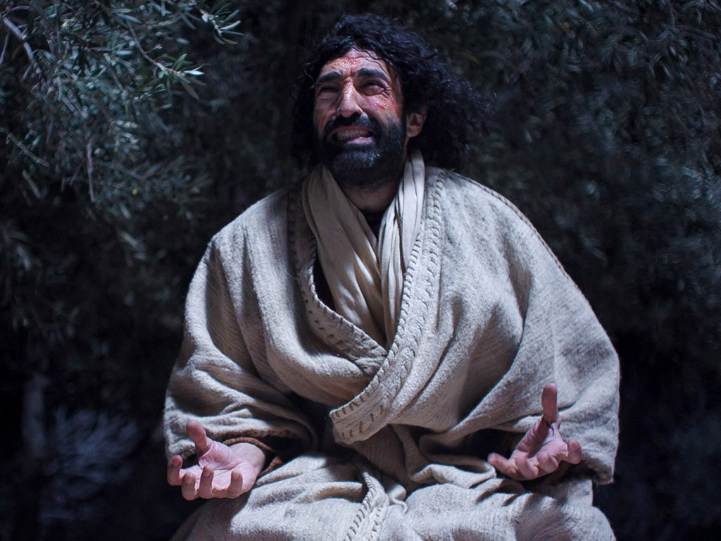
Free Bible images
Matthew 26:36-56
Mark 14:32-52
Luke 22:39-53
John 18:1-12
THE EASTER STORY
JESUS PRAYS IN GETHSEMANE

Slide 87
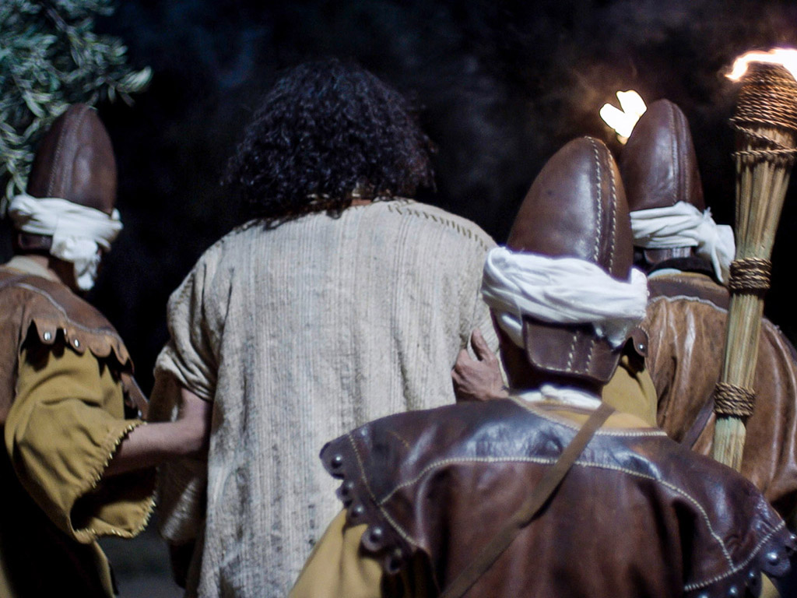

Slide 88
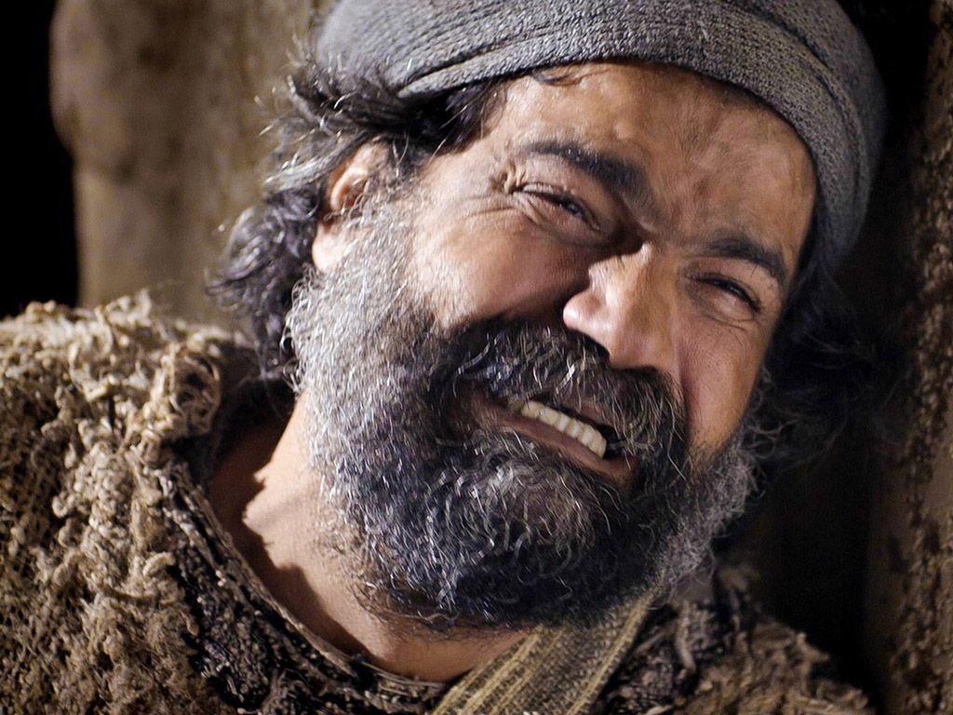
Free Bible images
Matthew 26:69-75
Mark 14:66-72
Luke 22:54-62
John 18:15-27
THE EASTER STORY
PETER DENIES JESUS

Slide 89
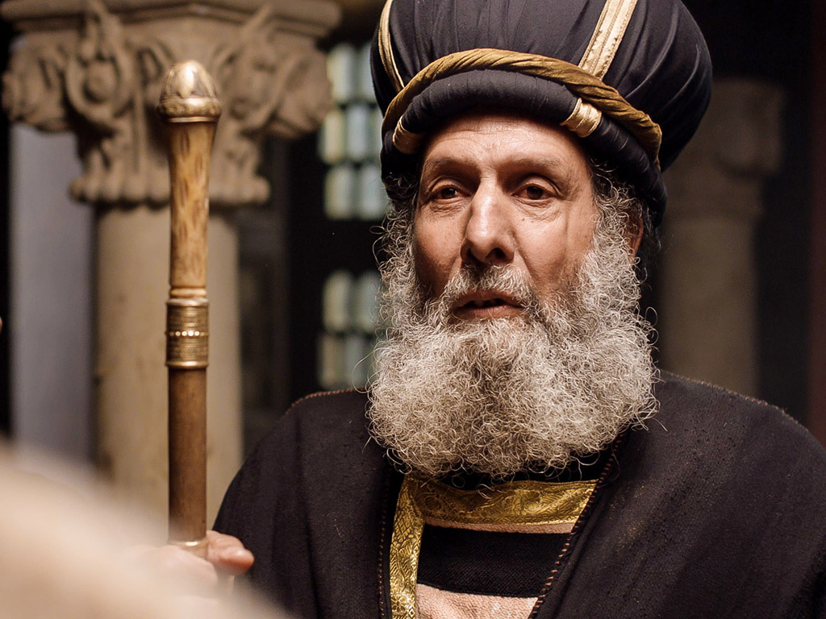
Free Bible images
Matthew 26:57-67
Mark 14:53-65
Luke 22:66-71
John 18:15-27
THE EASTER STORY
JESUS BEFORE THE SANHEDRIN
Notes:
Jesus’ arrest and trials repeatedly show him innocent of all charges leveled at him to confirm his sacrifice for the sins of the world—not his own sins (22:47–23:25).

Slide 90
Slides on Luke 23

Slide 91
Free Bible images
Matthew 27:27-37
Mark 15:16-25
Luke 23:26-34
John 19:16-27
THE EASTER STORY
JESUS IS CRUCIFIED

Slide 94
Slides on Luke 24

Slide 95
How to be confirmed…
…in our belief in Jesus
We can proclaim a risen Saviour to the world (Luke 24).
No one killed Christ because he willingly offered his life for us all (Luke 22–23).
God’s plan included Jewish rejection of Jesus to offer salvation to Gentiles (4:14–21:38).
God sent Jesus to be both Jewish and the universal Saviour (1:5–4:13).
Sources about Christ’s life are reliable (1:1-4).
Notes:
Christ's resurrection, commission, and ascension authenticate his ministry and atoning death as worthy of bringing to the nations.

Slide 96
Matthew 28:1-15
Mark 16:1-20
Luke 24:1-47
John 20:1-29
Free Bible images
THE EASTER STORY
JESUS IS ALIVE

Slide 99
Could mortals and those in glorified bodies really live together?
"And beginning with Moses and all the Prophets, he explained to them what was said in all the Scriptures concerning himself" (Luke 24:27 NIV)

Slide 101
How to be confirmed…
…in our belief in Jesus
We can proclaim a risen Saviour to the world (Luke 24).
No one killed Christ because he willingly offered his life for us all (Luke 22–23).
Jesus is Jewish but also the Universal Saviour (Main Idea).
God’s plan included Jewish rejection of Jesus to offer salvation to Gentiles (4:14–21:38).
God sent Jesus to be both Jewish and the universal Saviour (1:5–4:13).
Sources about Christ’s life are reliable (1:1-4).
Notes:
Christ is a Jew; however, that doesn't mean he cannot redeem Gentiles like those reading Luke's gospel.

Slide 102
The Half Life of Facts
Notes:
David McRaney, “The Half-Life of Facts,” BoingBoing, 27 Aug 2017, https://boingboing.net/2017/08/21/the-half-life-of-facts.html?utm_medium=referral&utm_source=idealmedia&utm_campaign=boingboing.net&utm_term=68704&utm_content=2143287

Slide 103
The Half Life of Facts
“In medical school, they tell you half of what you are about to learn won’t be true when you graduate — they just don’t know which half.
“In every field of knowledge, half of what is true today will one day be updated with better information, and it turns out that we actually know when that day will come for many academic pursuits."
David McRaney, “The Half-Life of Facts,” BoingBoing, 27 Aug 2017, https://boingboing.net/2017/08/21/the-half-life-of-facts.html?utm_medium=referral&utm_source=idealmedia&utm_campaign=boingboing.net&utm_term=68704&utm_content=2143287

Slide 104
The Half Life of Facts
“This is what author Sam Arbesman calls ‘the half-life of facts.’ The premise is that for every domain, silo, discipline, and school of knowledge, the facts contained within are slowly being overturned, augmented, replaced, and refined — and in medicine, for example, the rate of that overturning is high enough that if you never really complete your education. Medical school, in other words, never ends.”
David McRaney, “The Half-Life of Facts,” BoingBoing, 27 Aug 2017, https://boingboing.net/2017/08/21/the-half-life-of-facts.html?utm_medium=referral&utm_source=idealmedia&utm_campaign=boingboing.net&utm_term=68704&utm_content=2143287

Slide 105
The Half Life of Facts
“... For instance, in physics, about half of all research findings will be disconfirmed within 13 years. In psychology, it’s every seven. In other words, if you graduated with a degree in psychology seven years ago, half of the information in all your textbook is now inaccurate.”
David McRaney, “The Half-Life of Facts,” BoingBoing, 27 Aug 2017, https://boingboing.net/2017/08/21/the-half-life-of-facts.html?utm_medium=referral&utm_source=idealmedia&utm_campaign=boingboing.net&utm_term=68704&utm_content=2143287

Slide 106
The Unchanging Bible
Jesus is the Universal Saviour—but do you need to be confirmed that he is your Saviour?
Notes:
By contrast, the Bible claims to be the very “Word of God.” The fact that millions of people the world over have found that claim to be credible for 3500 years proves that the truths that matter the most are not nullified by the passing of time or rendered passé by better information. There is no half-life to the truth that God loves us or that Jesus came into this world to die for the sins of mankind. These truths are grounded in God’s unfailing nature and will never be overturned or replaced.
• Jesus is the Universal Saviour—but do you need to be confirmed that he is your Saviour?

Slide 107
The Unchanging Bible
“The grass withers and the flowers fall, but the word of our God endures forever” (Isaiah 40:8).
___________
“For I tell you truly, until heaven and earth pass away, not a single jot, not a stroke of a pen, will disappear from the Law until everything is accomplished” (Matthew 5:18).

Slide 108
Black

Slide 109
NT Preaching • BibleStudyDownloads.org
Get this presentation and script for free!

